Slide 1
CAPSTONE
Presented By,
Jerome Mathew
Neethu Satheesh
Harimurali K
Sreelekshmi Ajith Kumar
Renu Sebastian

Slide 2
CONTENTS
ANGULAR
1
KARMA
2
MONGODB
3

Slide 3
ANGULAR
Angular is an application design framework and development platform for creating efficient and sophisticated single-page apps.
As a platform, Angular includes:
A component-based framework for building scalable web applications
A collection of well-integrated libraries that cover a wide variety of features, including routing, forms management, client-server communication, and more
A suite of developer tools to help you develop, build, test, and update your code
Angular defines the security contexts:
HTML is used when interpreting a value as HTML
Style is used when binding CSS into the style property
URL is used for URL properties, such as <a href>
Resource URL is a URL that is loaded and executed as code

Slide 4
Why Angular
The Angular framework provides two-way data binding, It seamlessly synchronizes the data between Model as well as View.
With the latest Angular version, there have been a number of bug fixes and issues in compiler, route, core, service workers, modules and others have been resolved.
Angular CLI tool enables the Angular developers to create initial projects, perform tests and integrate diverse features in the same project while keeping the entire team on the same page.
Google is one of the biggest firms in technology and the talented pool of Google developers are offering Long-Term Support (LTS) for Angular to scale up enterprise Angular applications development.
Angular developers just need to map out what is needed and the framework will do the rest.

Slide 5
IMPLEMENTATION
Prerequisites
Install NodeJs
Install Angular Cli
Install Typescript globally
Basic understanding of Javascript
Basic knowledge about Angular
Node –version
npm –version
To Create your first application using angular CLI: npm install – g @angular/cli
Create new project by this command: ng new mynewapp
The directory contains e2e, node_modules, src, package.json, Other files

Slide 6
TESTING
Testing Angular application helps to check that app is working as you expect.
Testing is absolutely necessary to ensure your Angular app is maintainable.
There are two types of Angular testing:
Unit Testing is the process of testing small, isolated pieces of code. Also known as isolated testing, unit tests do not use external resources, such as the network or a database. Tools used for unit testing are Karma, Jest, Mocha, Selenium webdriver, Jasmine
Functional Testing refers to testing the functionality and of your Angular app from a user experience perspective — i.e., interacting with your app as it’s running in a browser just as a user would. Tools used for functional testing is Protractor

Slide 7
KARMA
Karma is a node based test tool that allows one to test Javascript codes.
Karma provides helpful tools that make it easier to us to call our jasmine tests while we are writing code
A node-based tool is any tool that needs the Node js engine installed for it to run and can be accessed through the node package manager (npm).
Karma is highly configurable, integrates with popular continuous integration packages like Jenkins and also it has an excellent plugin support.
Karma runs tests in different browsers and its runs from the console
Once code is changed on file system returns tests automatically
The main selling point of Karma is the ability to run tests against real browsers and real devices, which makes your testing strategy more robust and reliable.
Karma is very well suited to testing Angularjs or other JavaScript projects

Slide 8
Karma is a NodeJs application
So first install Node.js
Install Karma using npm
Npm Install Karma –cli –g
Npm Install Karma –save -dev
Karma requires a configuration file
Create using karma init
Requires a browser to run tests
Using karma we can use multiple browser at same time
Either in the congfig file
Or by navigating to localhost

Slide 9
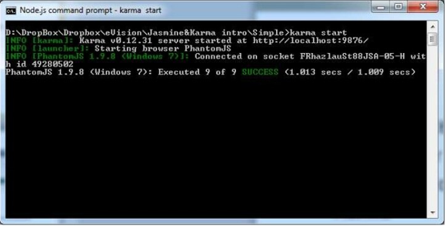
SUCCESSFUL TEST IN KARMA

Slide 10
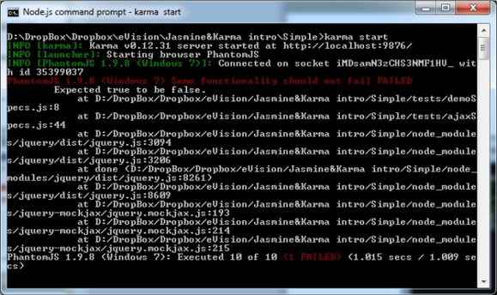
FAILING TEST IN KARMA

Slide 11
MongoDB
An open-source document database and leading NoSQL database.
A cross-platform, document oriented database that provides, high performance, high availability, and easy scalability. MongoDB works on concept of collection and document.
It can be used as a file storage system which is known as a GridFS.
Provides the different ways to perform aggregation operations on the data like aggregation pipeline, map reduce or single objective aggregation commands.
It can store any type of file which can be any size without effecting our stack​
MongoDB basically use JavaScript objects in place of procedure.
Like other RDBMS systems, MongoDB also provides official support for a large number of programming languages and frameworks.

Slide 12
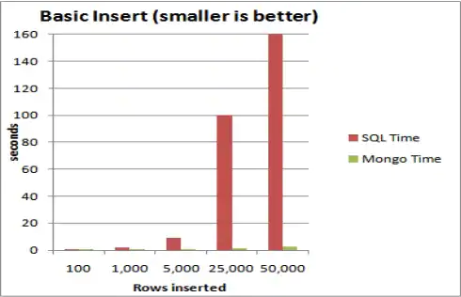
MongoDb Vs SQL

Slide 13
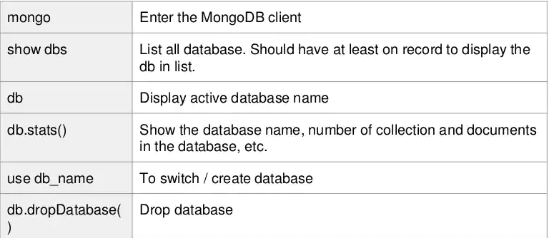
MongoDB COMMANDS

Slide 14
Where to use MongoDb
Big Data
Content Management and Delivery
Mobile and Social Infrastructure
User Data Management
Data Hub
ADVANTAGES
Flexible Database
Sharding
High Speed
DISADVANDAGES
High Memory Usage
Joins not supported
Limited Nesting

Slide 15
THANK YOU

